Slide 1
Agile Methodologies
Rinku Gupta (she/her) Argonne National Laboratory
Better Scientific Software tutorial @ SC21
Contributors: David E. Bernholdt (ORNL), Rinku K. Gupta (ANL), Michael A. Heroux (SNL), Mark C. Miller (LLNL), James M. Willenbring (SNL)

Slide 2

License, Citation and Acknowledgements
License and Citation
This work is licensed under a Creative Commons Attribution 4.0 International License (CC BY 4.0).
The requested citation the overall tutorial is: David E. Bernholdt, Anshu Dubey, Patricia A. Grubel, Rinku K. Gupta, and Gregory R. Watson, Better Scientific Software tutorial, in the International Conference for High-Performance Computing, Networking, Storage, and Analysis (SC21), St. Louis, MO, USA and online, 2021. DOI: 10.6084/m9.figshare.16556628
Individual modules may be cited as Speaker, Module Title, in Better Scientific Software tutorial…
Acknowledgements
This work was supported by the U.S. Department of Energy Office of Science, Office of Advanced Scientific Computing Research (ASCR), and by the Exascale Computing Project (17-SC-20-SC), a collaborative effort of the U.S. Department of Energy Office of Science and the National Nuclear Security Administration.
This work was performed in part at the Argonne National Laboratory, which is managed by UChicago Argonne, LLC for the U.S. Department of Energy under Contract No. DE-AC02-06CH11357.
This work was performed in part at the Oak Ridge National Laboratory, which is managed by UT-Battelle, LLC for the U.S. Department of Energy under Contract No. DE-AC05-00OR22725.
This work was performed in part at the Lawrence Livermore National Laboratory, which is managed by Lawrence Livermore National Security, LLC for the U.S. Department of Energy under Contract No. DE-AC52-07NA27344.
This work was performed in part at the Los Alamos National Laboratory, which is managed by Triad National Security, LLC for the U.S. Department of Energy under Contract No.89233218CNA000001
This work was performed in part at Sandia National Laboratories. Sandia National Laboratories is a multi-mission laboratory managed and operated by National Technology and Engineering Solutions of Sandia, LLC., a wholly owned subsidiary of Honeywell International, Inc., for the U.S. Department of Energy’s National Nuclear Security Administration under contract DE-NA0003525.

Slide 3
Outline
Small Team Models, Challenges
Agile workflow management for small teams.
Intro to terminology and approaches
Overview of Kanban
Building on Kanban
Free tools: Trello, GitHub

Slide 4
Small Teams
Ideas for managing transitions and steady work.

Slide 5
Small team interaction model
Team composition:
Senior staff, faculty:
Stable presence, in charge of science questions, experiments.
Know the conceptual models well.
Spend less time writing code, fuzzy on details.
Junior staff, students:
Transient, dual focus (science results, next position).
Staged experience: New, experienced, departing.
Learning conceptual models.
Write most code, know details.
Large teams have additional interaction challenges, and are often composed of smaller sub-teams.

Slide 6
Small team challenges
Heavy processes are often neither necessary nor appropriate
Adopt only those processes that add value
Ramping up new junior members:
Background.
Conceptual models.
Software practices, processes, tools.
Preparing for departure of experienced juniors.
Doing today those things needed for retaining work value.
Managing dual focus.

Slide 7
Research Team Member Lifecycle
Initiation Setup
Identify project activities
Create initiation checklist
Ramp Up
Work initiation checklist
Initiate project activities
Ongoing Planning
Kanban workflow
Observe policies
Start
Team Member Lifecycle
Quick ramp up
Disciplined activities
Sustained contributions
Repeat
Start process again
Ongoing Work
Conduct activities
Observe policies
Depart
Work complete
Work transferred
Contribution sustained
Ramp Down
Work exit checklist
Leave project activities
Exit Setup
Identify final deliverables
Create exit checklist

Slide 8
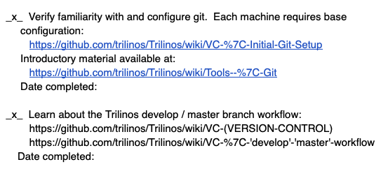
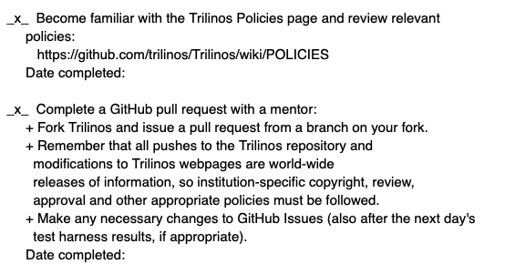
Checklists & Policies
New developer checklist snippet
Team Member Phase
New Team Member | Steady Contributor | Departing Member
Checklist | Policies | Checklist
New, departing team member checklists:
Example: Trilinos New Developer Checklist.
Simple – prevents omissions
https://github.com/trilinos/Trilinos/wiki/New-Trilinos-Developers
Steady state: Policy-driven.
Example: xSDK Community policies.
https://xsdk.info/policies/

Slide 9
Agile Methodologies

Slide 10
Why Agile?
Fits the research experience better than heavier-weight approaches
Aligns more naturally with how scientific progress is made
Well-suited for scientific software efforts (when tailored correctly)
Works well for small teams
Provides meaningful, beneficial structure that promotes
Productivity
Productization
Sustainability
Flexibility in requirements
Communication

Slide 11
What is Agile?
Agile is not a software development lifecycle model
I’ve seen Agile informally defined as
I don’t write documentation
I don’t do formal requirements, design, or really test…
Agile is not an excuse to do sloppy work
Some people consider agile to be synonymous with Scrum
From Atlassian: Scrum is a framework that helps teams work together
Scrum is Agile, Agile is not (only) Scrum
A square is a rectangle, not all rectangles are squares
Agile is not Kanban either

Slide 12
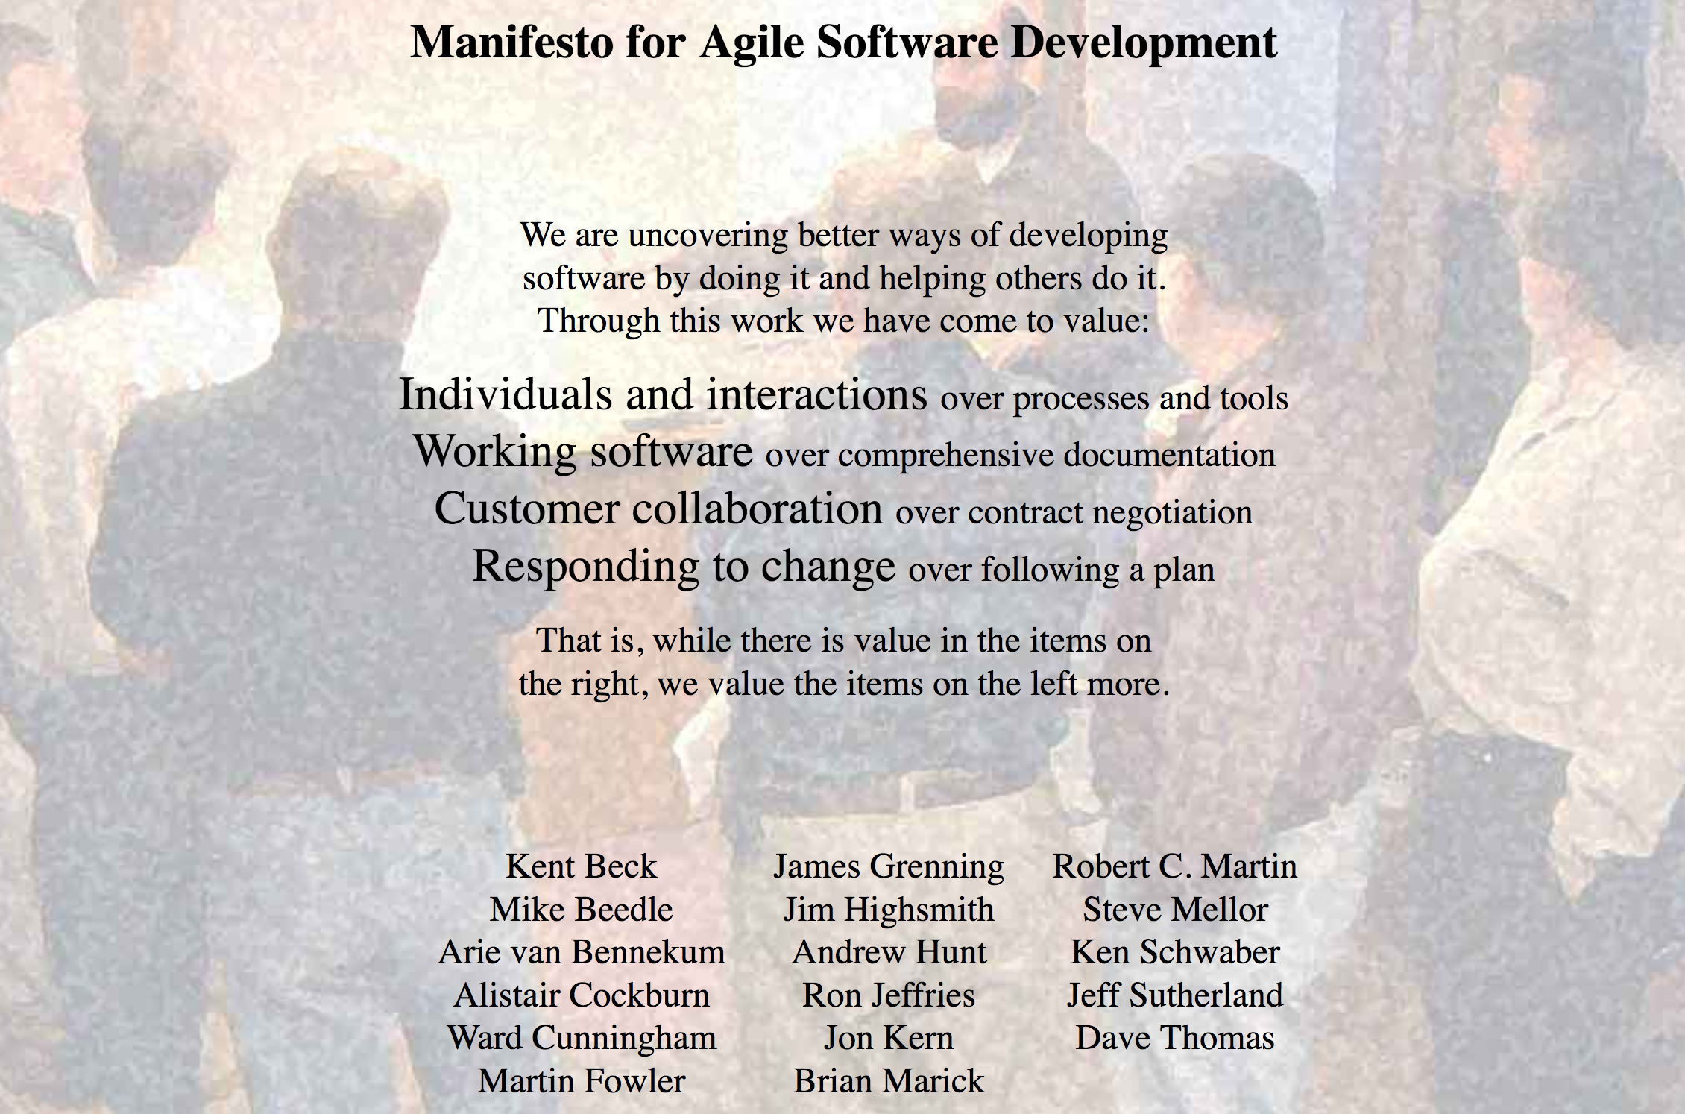
What is Agile?
http://agilemanifesto.org/

Slide 13
Principles behind the Agile Manifesto
Our highest priority is to satisfy the customer through early and continuous delivery of valuable software.
Welcome changing requirements, even late in development. Agile processes harness change for the customer's competitive advantage.
Deliver working software frequently, from a couple of weeks to a couple of months, with a preference to the shorter timescale.
Business people and developers must work together daily throughout the project.
Build projects around motivated individuals. Give them the environment and support they need, and trust them to get the job done.
The most efficient and effective method of conveying information to and within a development team is face-to-face conversation.

Slide 14
Principles behind the Agile Manifesto
Working software is the primary measure of progress.
Agile processes promote sustainable development. The sponsors, developers, and users should be able to maintain a constant pace indefinitely.
Continuous attention to technical excellence and good design enhances agility.
Simplicity--the art of maximizing the amount of work not done- is essential.
The best architectures, requirements, and designs emerge from self-organizing teams.
At regular intervals, the team reflects on how to become more effective, then tunes and adjusts its behavior accordingly.

Slide 15
Getting Started with Agile
Agile principles are not hard and fast rules
Try adopting a few Agile practices
Following a rigid, ill-fit framework usually leads to failure
Kanban is a good starting framework
Follow basic principles, add practices when advantageous
Better than removing elements from Scrum
Task: Have Eureka moment by Tuesday.
Scrum

Slide 16
Basic Kanban
Backlog | Ready | In Progress | Done
Any task idea Trim occasionally Source for other columns | Task + description of how to do it. Could be pulled when slot opens. Typically comes from backlog. | Task you are working on right now. The only Kanban rule: Can have only so many “In Progress” tasks. Limit is based on experience, calibration. Key: Work is pulled. You are in charge! | Completed tasks. Record of your life activities. Rate of completion is your “velocity”.
Notes:
Ready column is not strictly required, sometimes called “Selected for development”.
Other common column: In Review
Can be creative with columns:
Waiting on Advisor Confirmation.
Blocked

Slide 17
Kanban principles
Limit number of “In Progress” tasks
Must be tuned by each team
Common convention: 2n-1 tasks where n = # team members
Productivity improvement:
Optimize “flexibility vs swap overhead” balance. No overcommitting.
Productivity weakness exposed as bottleneck. Team must identify and fix the bottleneck.
Effective in R&D setting. Avoids a deadline-based approach. Deadlines are dealt with in a different way.
Provides a board for viewing and managing issues

Slide 18

Personal Kanban
Personal Kanban: Kanban applied to one person.
Apply Kanban principles to your life.
Fully adaptable.
Personal Kanban: Commercial book/website.
Useful, but not necessary.
http://www.personalkanban.com
https://bssw.io/items/using-personal-kanban-for-productivity

Slide 19
Kanban tools
Wall, whiteboard, blackboard: Basic approach.
Software, cloud-based:
Trello, JIRA, GitHub Issues & Project Board.
Many more.
I use Trello (browser, Android, iPhone, iPad).
Can add, view, update, anytime, anywhere.
Different boards for different contexts
Effective when people are split on multiple projects

Slide 20
Big question: How many tasks?
No single answer. Choose something and adjust from there.
Personal Kanban approach: Start with 2 or 3.
Use a freeway traffic analogy:
Does traffic flow best when fully packed? No.
Same thing with your effectiveness.
Spend time consulting board regularly.
Brings focus.
Enables reflection, retrospection.
Use slack time effectively.
When you get out of the habit, start up again.
Steers towards previously started tasks

Slide 21
Importance of “In Progress” concept for you
Junior community members:
Less control over tasks.
Given by supervisor.
In Progress column: Protects you.
If asked to take on another task, respond:
Is this important enough to
back-burner a, b, and c?
become less efficient?
Sometimes it is.

Slide 22
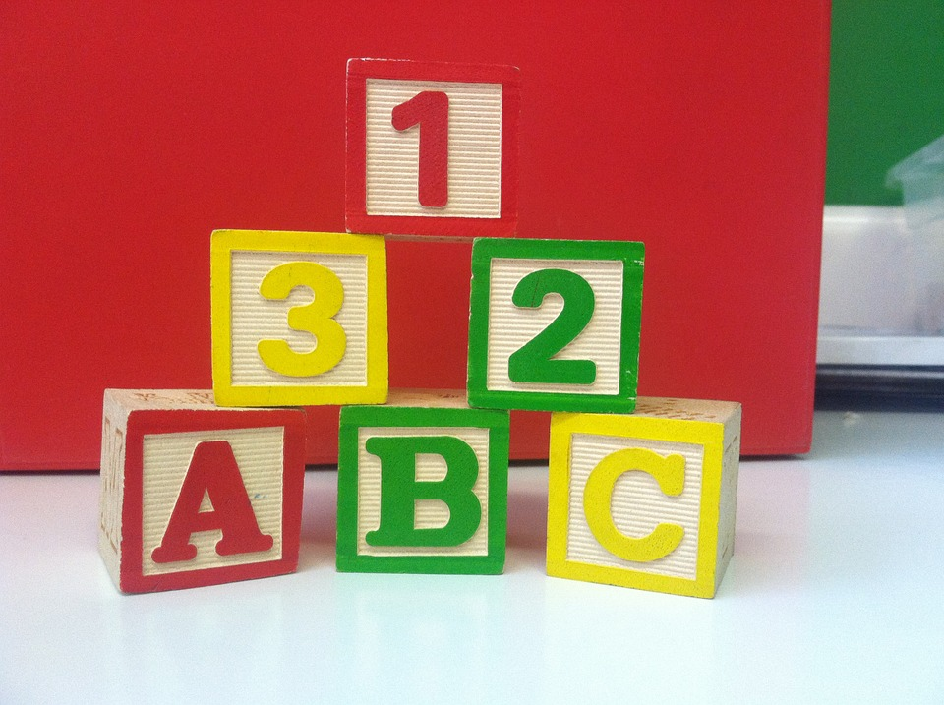
Building on Kanban
Focus: Solve issues!
(not add process)
15 minute stand-ups
Maybe not daily
Planning meetings
Retrospectives
Scrum Master
Product Owner
Epic, story, task
Definition of Done

Slide 23
Building on Kanban
Epic, Story, Task
Formal or informal
Start with high-level requirements
Break down and refine when and as needed
Close to when the work will be done
Only for work that will take place
Can be valuable for estimating
There is no “correct” level of granularity
Epics are very high level objectives
Stories should represent an increment of value to the customer
”Done” criteria – understandable to user
Tasks are the steps necessary to complete a story
May not individually provide value to the customer

Slide 24
Building on Kanban
User stories (optional)
Form: As a <stakeholder>, I want <describe what is needed> so that <why do you want this?>
Can be useful to improve communication and requirements elicitation
In heat example:
User stories collected
As a developer, I want to modularize the heat equation utilities so that I can more easily make use of the utilities for other projects.
As a developer, I want to be able to use multiple integration functions easily so that I can utilize the function best suited for the problem I am solving.

Slide 25
Building on Kanban
Epic (derived from user stories): Refactor code for enhanced modularity
Description: The heat equation code needs refactoring to improve modularity. Specifically, there are utilities that could be generalized and used with for other applications. Also, the integration function is currently hard-coded. In the future, we want to use alternative integration functions, so we should generalize the interface for this function.
Story 1: Separate out utilities
Story 2: Separate out integration function
This idea needs to be socialized with stakeholders
No staffing/funding currently available

Slide 26
Samples from Collegeville Org: Kanban Board

Slide 27
Kanban in GitHub
GitHub supports basic Agile development workflows
Filing issues
@mention
Kanban board
Projects
GitHub lacks more advanced features
Dependencies between issues
You can reference one issue in another
Advanced notification schemes
Custom fields
You can create custom labels

Slide 28

Building on Kanban
A-Team Tools: A collection of resources for understanding and applying lightweight agile practices to your scientific SW project
Especially useful for
Small teams
Teams of teams
Teams that frequently have members come and go
https://betterscientificsoftware.github.io/A-Team-Tools/

Slide 29


Other Resources
The Agile Samurai: How Agile Masters Deliver Great Software (Pragmatic Programmers), Jonathan Rasmusson.
http://a.co/eUGIe95
Excellent, readable book on Agile methodologies.
Also available on Audible.
Code Complete: A Practical Handbook of Software Construction, Steve McConnell.
http://a.co/eEgWvKj
Great text on software.
Construx website has large collection of content.
More Effective Agile: A Roadmap for Software Leaders, Steve McConnell.
http://a.co/22EPvt6
New: A realistic view of Agile effectiveness with great advice for project leaders.

Slide 30
A Bit about Scrum: Roles
Scrum team
Product Owner
Interface between development team and stakeholders. Responsible for defining and managing work backlog. Needs good domain knowledge. Needs adequate time to do job well.
Scrum Master
Leads and coaches development team. Assures scrum processes followed. Needs good Scrum knowledge and discipline. Can be a developer if sufficient time.
Development Team
Cross-functional group of 3 – 9 that develops product. Completes all work necessary to be done-done. Collectively need design, development, testing, documentation skills. Works in collaboration with product owner, scrum master.

Slide 31
A Bit about Scrum: Process
15-min standup
What did you do yesterday?
What will you do today?
What is blocking progress?
Daily scrum
Product Backlog
Prioritized requirements, features of the product
Sprint Backlog
Enough work for sprint; integral capabilities
Increment
Product with new working features.
*Sprint Planning
Sprint: 1 – 3 weeks
Sprint Review
Retrospective
Repeat
* Sprint planning happens during previous sprint

